Slide 1
COMP-4150 ADVANCED AND PRACTICAL DB SYSTEMS
PART-A- Lecture notes on OVERVIEW OF DATABASE AND COMPONENTS
Fall-2019

Slide 2
OUTLINE
SECTION-I - Introduction
Overview
Architecture
Data Models
Data Schemas
Data Independence
SECTION-III- Relational Model
Relational Data Model
Relational Algebra
ER to Relational Model
SQL Overview
SECTION-II- ER Modeling
ER-Model Basic Concepts
ER-Diagram Representation
Generalization, Aggregation
SECTION-IV-Relational DB Design
Database Normalization
Database Joins
Generalization, Aggregation

Slide 3
OUTLINE
SECTION-V-Storage and File Structure
Storage System
File Structure
SECTION-VII- Transaction and Concurrency
Transaction
Concurrency Control
Deadlock
SECTION-VI- Indexing and Hashing
Indexing
Hashing
SECTION-VIII- Backup and Recovery
Data Back up
Data Recovery

Slide 4
SECTION-I - Introduction
Overview
Architecture
Data Models
Data Schemas
Data Independence

Slide 5
Data Base
Database is a collection of related data
Data is a collection of facts and figures that can be processed to produce information.
Mostly data represents recordable facts. Data aids in producing information, which is based on facts. For example, if we have data about marks obtained by all students, we can then conclude about toppers and average marks.
A database management system stores data in such a way that it becomes easier to retrieve, manipulate, and produce information.

Slide 6
Characteristics of a Database
A modern DBMS has the following characteristics −
Real-world entity − A modern DBMS is more realistic and uses real-world entities to design its architecture. It uses the behavior and attributes too. For example, a school database may use students as an entity and their age as an attribute.
Relation-based tables − DBMS allows entities and relations among them to form tables. A user can understand the architecture of a database just by looking at the table names.
Isolation of data and application − A database system is entirely different than its data. A database is an active entity, whereas data is said to be passive, on which the database works and organizes. DBMS also stores metadata, which is data about data, to ease its own process.

Slide 7
Characteristics of a Database
Less redundancy − DBMS follows the rules of normalization, which splits a relation when any of its attributes is having redundancy in values
Consistency − Consistency is a state where every relation in a database remains consistent. A DBMS can provide greater consistency as compared to earlier forms of data storing applications like file-processing systems.
Query Language − DBMS is equipped with query language, which makes it more efficient to retrieve and manipulate data.
ACID Properties − DBMS follows the concepts of Atomicity, Consistency, Isolation, and Durability (normally shortened as ACID). These concepts are applied on transactions, which manipulate data in a database. ACID properties help the database stay healthy in multi-transactional environments and in case of failure.

Slide 8
Characteristics of a Database
Multiuser and Concurrent Access − DBMS supports multi-user environment and allows them to access and manipulate data in parallel.
Multiple views − DBMS offers multiple views for different users. A user who is in the Sales department will have a different view of database than a person working in the Production department.
Security − DBMS offers methods to impose constraints while entering data into the database and retrieving the same at a later stage. DBMS offers many different levels of security features, which enables multiple users to have different views with different features.
For example, a user in the Sales department cannot see the data that belongs to the Purchase department. Additionally, it can also be managed how much data of the Sales department should be displayed to the user.

Slide 9
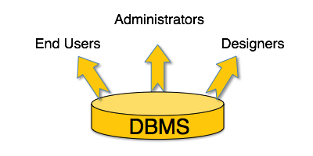
DBMS- Users
Administrators − Administrators maintain the DBMS and are responsible for administrating the database. Look after its usage and by whom it should be used. They create access profiles for users and apply limitations to maintain isolation and force security. Administrators also look after DBMS resources like system license, required tools, and other software and hardware related maintenance.
Designers − Designers are the group of people who actually work on the designing part of the database. They keep a close watch on what data should be kept and in what format. They identify and design the whole set of entities, relations, constraints, and views.
End Users − End users are those who actually reap the benefits of having a DBMS. End users can range from simple viewers who pay attention to the logs or market rates to sophisticated users such as business analysts.

Slide 10
DBMS- Architecture
1-tier Architecture
DBMS is the only entity where the user directly sits on the DBMS and uses it. Any changes done here will directly be done on the DBMS itself. It does not provide handy tools for end-users. Database designers and programmers normally prefer to use single-tier architecture.
2-tier Architecture
Have an application through which the DBMS can be accessed. Programmers use 2-tier architecture where they access the DBMS by means of an application. Here the application tier is entirely independent of the database in terms of operation, design, and programming.
3-tier Architecture
A 3-tier architecture separates its tiers from each other based on the complexity of the users and how they use the data present in the database. It is the most widely used architecture to design a DBMS.

Slide 11
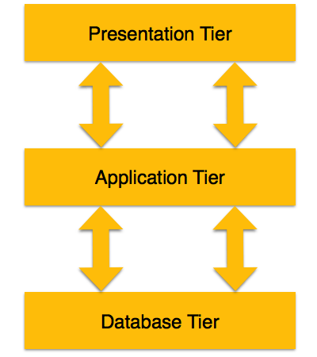
3-Tier Architecture
Database (Data) Tier − The database resides along with its query processing languages. Relations that define the data and their constraints at this level are also defined.
Application (Middle) Tier − At this tier reside the application server and the programs that access the database. For a user, this application tier presents an abstracted view of the database. End-users are unaware of any existence of the database beyond the application. At the other end, the database tier is not aware of any other user beyond the application tier. Hence, the application layer sits in the middle and acts as a mediator between the end-user and the database.
User (Presentation) Tier − End-users operate on this tier and they know nothing about any existence of the database beyond this layer. At this layer, multiple views of the database can be provided by the application. All views are generated by applications that reside in the application tier.

Slide 12
Data Models
Data models define how the logical structure of a database is modeled.
How data is connected to each other, processed and stored inside the system.
Entity-Relationship Model
Entity-Relationship (ER) Model is based on the notion of real-world entities and relationships among them. While formulating real-world scenario into the database model, the ER Model creates entity set, relationship set, general attributes and constraints.
ER Model is best used for the conceptual design of a database.
ER Model is based on −
Entities and their attributes.
Relationships among entities.

Slide 13
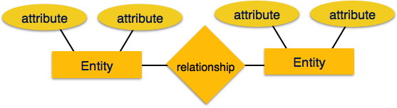
Entities & Relationships
Entity − An entity in an ER Model is a real-world entity having properties called attributes. Every attribute is defined by its set of values called domain. For example, in a school database, a student is considered as an entity. Student has various attributes like name, age, class, etc.
Relationship − The logical association among entities is called relationship. Relationships are mapped with entities in various ways. Mapping cardinalities define the number of association between two entities.
Mapping cardinalities −
one to one
one to many
many to one
many to many

Slide 14
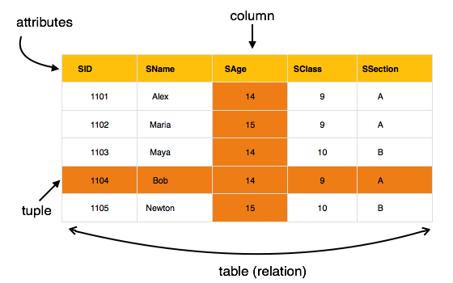
Relational Model
The most popular data model in DBMS is the Relational Model. It is more scientific a model than others. This model is based on first-order predicate logic and defines a table as an n-ary relation.
The main highlights of this model are −
Data is stored in tables called relations.
Relations can be normalized.
In normalized relations, values saved are atomic values.
Each row in a relation contains a unique value.
Each column in a relation contains values from a same domain.

Slide 15
DB Schema
Skeleton structure that represents the logical view of the entire database.
It defines how the data is organized and how the relations among them are associated.
It formulates all the constraints that are to be applied on the data.
A database schema defines its entities and the relationship among them.
It contains a descriptive detail of the database, which can be depicted by means of schema diagrams. It’s the database designers who design the schema to help programmers understand the database and make it useful.

Slide 16
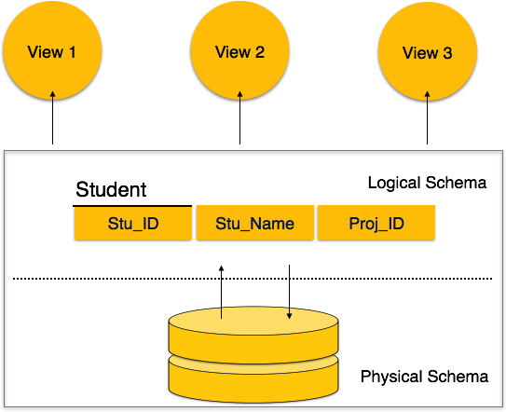
Data Base Schema
A database schema can be divided broadly into two categories −
Physical Database Schema − This schema pertains to the actual storage of data and its form of storage like files, indices, etc. It defines how the data will be stored in a secondary storage.
Logical Database Schema − This schema defines all the logical constraints that need to be applied on the data stored. It defines tables, views, and integrity constraints.

Slide 17
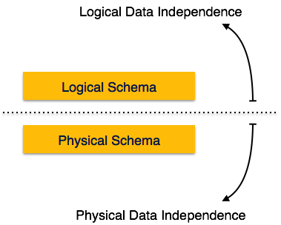
Data Independence
Logical Data Independence
Logical data is data about database, it stores information about how data is managed inside.
For example, a table (relation) stored in the database and all its constraints, applied on that relation. If we do some changes on table format, it should not change the data residing on the disk.
Physical Data Independence
All the schemas are logical, and the actual data is stored in bit format on the disk. This independence means change the physical data without impacting the schema or logical data.
For example, in case we want to change or upgrade the storage system itself − suppose we want to replace hard-disks with SSD − it should not have any impact on the logical data or schemas.

Slide 18
SECTION-II- ER Modeling
ER-Model Basic Concepts
ER-Diagram Representation
Generalization, Aggregation

Slide 19
ER Model Basic Concepts
Entity
A real-world object, that can be easily identifiable.
For example, in a school database, students, teachers, classes, and courses offered
All these entities have some attributes or properties that give them their identity.
An entity set is a collection of similar types of entities. An entity set may contain entities with attribute sharing similar values. For example, a Students set may contain all the students of a school; likewise a Teachers set may contain all the teachers of a school from all faculties
Attributes
Entities are represented by means of their properties, called attributes.
All attributes have values.
For example, a student entity may have name, class, and age as attributes.
There exists a domain or range of values that can be assigned to attributes.
For example, a student's name cannot be a numeric value. It has to be alphabetic. A student's age cannot be negative, etc.

Slide 20
Attribute Types
Simple attribute − Simple attributes are atomic values, which cannot be divided further. For example, a student's phone number is an atomic value of 10 digits.
Composite attribute − Composite attributes are made of more than one simple attribute. For example, a student's complete name may have first_name and last_name.
Derived attribute − Derived attributes are the attributes that do not exist in the physical database, but their values are derived from other attributes present in the database. For example, average_salary in a department should not be saved directly in the database, instead it can be derived. For another example, age can be derived from data_of_birth.
Single-value attribute − Single-value attributes contain single value. For example − Social_Security_Number.
Multi-value attribute − Multi-value attributes may contain more than one values. For example, a person can have more than one phone number, email_address, etc.

Slide 21
Entity-Set and Keys
Key is an attribute or collection of attributes that uniquely identifies an entity among entity set.
For example, the roll_number of a student makes him/her identifiable among students.
Super Key − A set of attributes (one or more) that collectively identifies an entity in an entity set.
Candidate Key − A minimal super key is called a candidate key. An entity set may have more than one candidate key.
Primary Key − A primary key is one of the candidate keys chosen by the database designer to uniquely identify the entity set.

Slide 22
Relationship
The association among entities is called a relationship. For example, an employee works_ata department, a student enrolls in a course. Here, Works_at and Enrolls are called relationships.
Relationship Set
A set of relationships of similar type is called a relationship set. Like entities, a relationship too can have attributes. These attributes are called descriptive attributes.
Degree of Relationship
The number of participating entities in a relationship defines the degree of the relationship.
Binary = degree 2
Ternary = degree 3
n-ary = degree

Slide 23
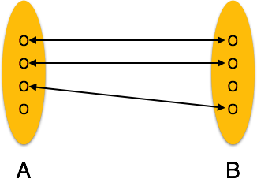
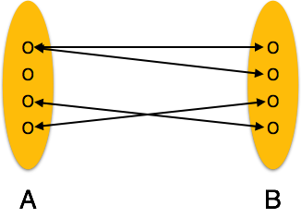
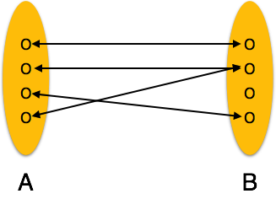
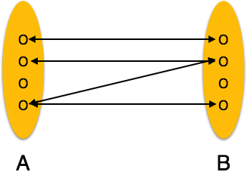
Mapping Cardinalities
Cardinality defines the number of entities in one entity set, which can be associated with the number of entities of other set via relationship set.
One-to-one − One entity from entity set A can be associated with at most one entity of entity set B and vice versa.
One-to-many − One entity from entity set A can be associated with more than one entities of entity set
Many-to-one − More than one entities from entity set A can be associated with at most one entity of entity set B, however an entity from entity set B can be associated with more than one entity from entity set A.B however an entity from entity set B, can be associated with at most one entity
Many-to-many − One entity from A can be associated with more than one entity from B and vice versa.

Slide 24
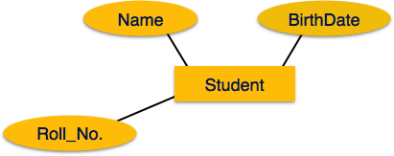
ER-Diagram
Entity
Entities are represented by means of rectangles. Rectangles are named with the entity set they represent.
Attributes
Attributes are the properties of entities.
Represented by means of ellipses.
Every ellipse represents one attribute and is directly connected to its entity (rectangle).

Slide 25
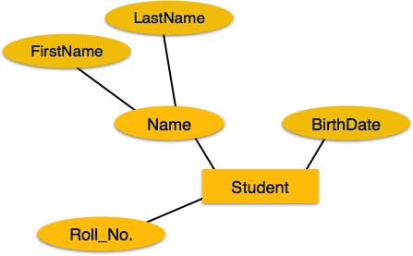
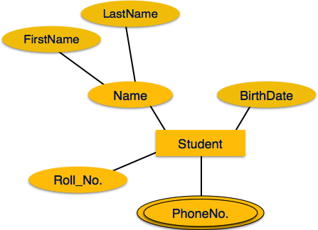
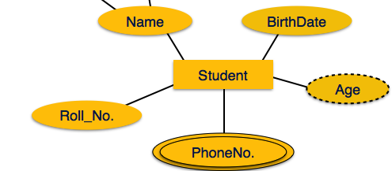
More on Attributes
If the attributes are composite, they are further divided in a tree like structure. Every node is then connected to its attribute. Composite attributes are represented by ellipses that are connected with an ellipse.
Multivalued attributes are depicted by double ellipse.
Derived attributes are depicted by dashed ellipse.

Slide 26
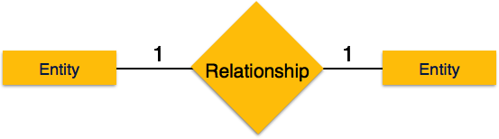
Relationship
Relationships are represented by diamond-shaped box. Name of the relationship is written inside the diamond-box. All the entities (rectangles) participating in a relationship, are connected to it by a line.
Binary Relationship and Cardinality
A relationship where two entities are participating is called a binary relationship. Cardinality is the number of instance of an entity from a relation that can be associated with the relation.
One-to-one − When only one instance of an entity is associated with the relationship, it is marked as '1:1'. The following image reflects that only one instance of each entity should be associated with the relationship. It depicts one-to-one relationship.

Slide 27
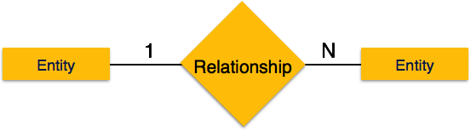
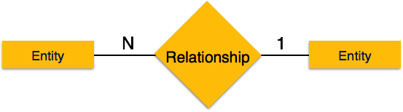

Relationships (Continued)
One-to-many − When more than one instance of an entity is associated with a relationship, it is marked as '1:N'.
Many-to-one − When more than one instance of entity is associated with the relationship, it is marked as 'N:1'.
Many-to-many − More than one instance of an entity on the left and more than one instance of an entity on the right can be associated with the relationship. It depicts many-to-many relationship.

Slide 28
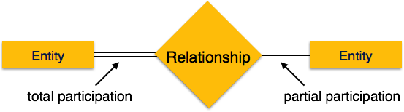
Participation Constraints
Total Participation − Each entity is involved in the relationship.
Total participation is represented by double lines.
Partial participation − Not all entities are involved in the relationship. Partial participation is represented by single lines.

Slide 29
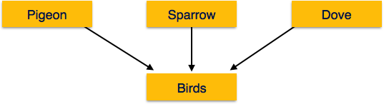
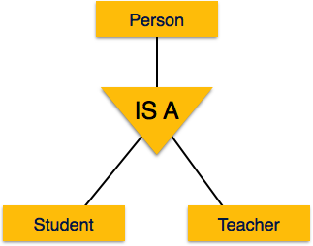
Generalization & Specialization
Generalization
A number of entities are brought together into one generalized entity based on their similar characteristics.
For example, pigeon, house sparrow, crow and dove can all be generalized as Birds.
Specialization
A group of entities is divided into sub-groups based on their characteristics.
Take a group ‘Person’. A person has name, date of birth, gender, etc. These properties are common in all persons, human beings. But in a company, persons can be identified as employee, employer, customer, or vendor, based on what role they play in the company.

Slide 30
SECTION-III- Relational Model
Relational Data Model
Relational Algebra
ER to Relational Model
SQL Overview

Slide 31
Relational Data Model
Relational data model is the primary data model .
Tables − Relations are saved in the format of Tables. This format stores the relation among entities. A table has rows and columns, where rows represents records and columns represent the attributes.
Tuple − A single row of a table, which contains a single record for that relation is called a tuple.
Relation instance − A finite set of tuples in the relational database system represents relation instance. Relation instances do not have duplicate tuples.
Relation schema − A relation schema describes the relation name (table name), attributes, and their names.
Relation key − Each row has one or more attributes, known as relation key, which can identify the row in the relation (table) uniquely.
Attribute domain − Every attribute has some pre-defined value scope, known as attribute domain.

Slide 32
Constraints
Every relation has some conditions that must hold for it to be a valid relation. These conditions are called Relational Integrity Constraints. There are three main integrity constraints −
Key constraints
Domain constraints
Referential integrity constraints

Slide 33
Key Constraints
Key Constraints
At least one minimal subset of attributes in the relation, which can identify a tuple uniquely.
Minimal subset of attributes is called key for that relation.
More than one such minimal subsets, these are called candidate keys.
Key constraints force that :
No two tuples can have identical values for key attributes.
A key attribute can not have null values.
Also referred to as entity constraints

Slide 34
Domain & Referential Integrity Constraints
Domain Constraints
Attributes have specific values in real-world scenario.
Every attribute is bound to have a specific range of values.
For example, age cannot be less than zero and telephone numbers cannot contain a digit outside 0-9.
Referential integrity Constraints
Referential Integrity constraints work on the concept of Foreign Keys.
A foreign key is a key attribute of a relation that can be referred in other relation.
Referential integrity constraint states that if a relation refers to a key attribute of a different or same relation, then that key element must exist.

Slide 35
Relational Algebra & Relational Calculus
Relational database systems are equipped with a query language that can assist its users to query the database instances.
There are two kinds of query languages −
Relational algebra
Relational calculus

Slide 36
Relational Algebra
Procedural query language, which takes instances of relations as input and yields instances of relations as output.
Uses operators to perform queries.
An operator can be either unary or binary
The fundamental operations of relational algebra are as follows −
Select
Project
Union
Set different
Cartesian product
Rename

Slide 37
Relational Algebra-SELECT operation(σ)
It selects tuples that satisfy the given predicate from a relation.
Notation − σ_{p}(r)
Where σ stands for selection predicate and r stands for relation. p is prepositional logic formula which may use connectors like and, or, and not. These terms may use relational operators like − =, ≠, ≥, < , >, ≤.
For example −
Output − Selects tuples from books where subject is 'database'
Output − Selects tuples from books where subject is 'database' and 'price' is 450.
σ_{subject = "database"}(Books)
σsubject = "database" and price = "450"(Books)

Slide 38
Relational Algebra - Project Operation (∏)
It projects column(s) that satisfy a given predicate.
Notation − ∏_{A1, A2, An} (r)
Where A₁, A₂ , A_{n} are attribute names of relation r.
Duplicate rows are automatically eliminated, as relation is a set.
For example −
∏_{subject, author}(Books)
Selects and projects columns named as subject and author from the relation Books.

Slide 39
Relational Algebra - Union Operation (∪)
It performs binary union between two given relations and is defined as −
r ∪ s = { t | t ∈ r or t ∈ s}
Notation − r U s
Where r and s are either database relations or relation result set (temporary relation).
For a union operation to be valid, the following conditions must hold −
r, and s must have the same number of attributes.
Attribute domains must be compatible.
Duplicate tuples are automatically eliminated.
∏ _{author} (Books) ∪ ∏ _{author}(Articles)
Output − Projects the names of the authors who have either written a book or an article or both.

Slide 40
Relational Algebra- Set Difference (−)
Set Difference (−)
The result of set difference operation is tuples, which are present in one relation but are not in the second relation.
Notation − r − s
Finds all the tuples that are present in r but not in s.
Output − Provides the name of authors who have written books but not articles.
∏ _{author} (Books) − ∏ _{author} (Articles)

Slide 41
Relational Algebra-Cartesian Product (Χ)
Combines information of two different relations into one.
Notation − r Χ s
Where r and s are relations and their output will be defined as −
r Χ s = { q t | q ∈ r and t ∈ s}
Output − Yields a relation, which shows all the books and articles written by “James”
σ _{author = ‘James‘} (Books Χ Articles)

Slide 42
Relational Algebra-Rename Operation (ρ)
The results of relational algebra are also relations but without any name. The rename operation allows us to rename the output relation. 'rename' operation is denoted with small Greek letter rho ρ.
Notation − ρ _{x} (E)
Where the result of expression E is saved with name of x.
Additional operations are −
Set intersection
Assignment
Natural join

Slide 43
Relational Calculus
Relational Calculus is a non-procedural query language, that is, it tells what to do but never explains how to do it.
Relational calculus exists in two forms −
Tuple Relational Calculus (TRC)
Filtering variable ranges over tuples
Notation − {T | Condition}
Returns all tuples T that satisfies a condition.
For example −
{ T.name | Author(T) AND T.article = 'database' }
Output − Returns tuples with 'name' from Author who has written article on 'database'.

Slide 44
Relational Calculus- Tuple Relational Calculus
TRC can be quantified. We can use Existential (∃) and Universal Quantifiers (∀).
For example −
{ R| ∃T ∈ Authors(T.article='database' AND R.name=T.name)}
Output −
The above query will yield the same result as the previous one.

Slide 45
Relational Calculus- Domain Relational Calculus
In DRC, the filtering variable uses the domain of attributes instead of entire tuple values (as done in TRC, mentioned above).
Notation −
{ a₁, a₂, a₃, ..., a_{n} | P (a₁, a₂, a₃, ... ,a_{n})}
Where a1, a2 are attributes and P stands for formulae built by inner attributes.
For example −
{< article, page, subject > | ∈ Books ∧ subject = 'database'}
Output − Yields Article, Page, and Subject from the relation Books, where subject is database

Slide 46
SQL Overview
SQL is a programming language for Relational Databases.
It is designed over relational algebra and tuple relational calculus.
SQL comes as a package with all major distributions of RDBMS.
SQL comprises both data definition and data manipulation languages.
Data Definition properties of SQL, one can design and modify database schema,
Data Manipulation properties allows SQL to store and retrieve data from database.

Slide 47
SQL-Data Definition Language (DDL)
SQL uses the following set of commands to define database schema
1. CREATE
Creates new databases, tables and views from RDBMS.
For example −
Create database Books;
Create table article;
Create view for_students;
2. DROP
Drops commands, views, tables, and databases from RDBMS.
For example−
Drop object_type object_name;
Drop database Books;
Drop table article;
Drop view for_students;
3. ALTER
Modifies database schema
For example−
Alter table article add subject varchar;

Slide 48
SQL-Data Manipulation Language (DML)
SQL is equipped with data manipulation language (DML).
DML modifies the database instance by inserting, updating and deleting its data.
SQL contains the following set of commands in its DML section −
SELECT/FROM/WHERE
INSERT INTO/VALUES
UPDATE/SET/WHERE
DELETE FROM/WHERE

Slide 49
DML-SELECT/FROM/WHERE
SELECT − It selects the attributes based on the condition described by WHERE clause.
FROM − This clause takes a relation name as an argument from which attributes are to be selected/projected.
WHERE − This clause defines predicate or conditions, which must match in order to qualify the attributes to be projected.
For example −
Select author_name
From book_author
Where age > 50;
This command will yield the names of authors from the relation book_author whose age is greater than 50.

Slide 50
DML-INSERT INTO/VALUES
This command is used for inserting values into the rows of a table (relation).
Syntax−
INSERT INTO table (column1 [, column2, column3 ... ]) VALUES (value1 [, value2, value3 ... ])
Or
INSERT INTO table VALUES (value1, [value2, ... ])
For example −
INSERT INTO Books (Author, Subject) VALUES ("anonymous", "computers");

Slide 51
DML-UPDATE/SET/WHERE
This command is used for updating or modifying the values of columns in a table (relation).
Syntax −
UPDATE table_name SET column_name = value [, column_name = value ...] [WHERE condition]
For example −
UPDATE Books SET Author=“John" WHERE Author="anonymous";

Slide 52
DML-DELETE/FROM/WHERE
This command is used for removing one or more rows from a table (relation).
Syntax −
DELETE FROM table_name [WHERE condition];
For example −
DELETE FROM Books
WHERE Author="unknown";

